Slide 1
How do I access delinquency data?
Hover over “Taxpayer Services and click on “File Downloads

Slide 2
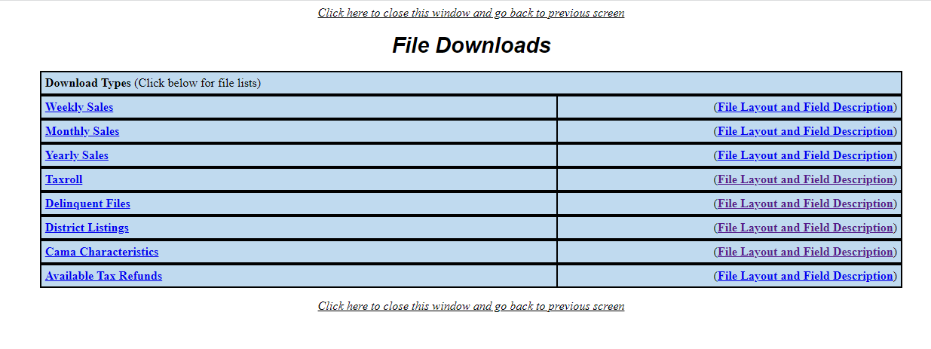
How do I access delinquency data?
Click on “Delinquent Files”
Don’t forget to also download the corresponding File Record Layout. You’ll need it to understand what each category in the Delinquent File means.

Slide 3
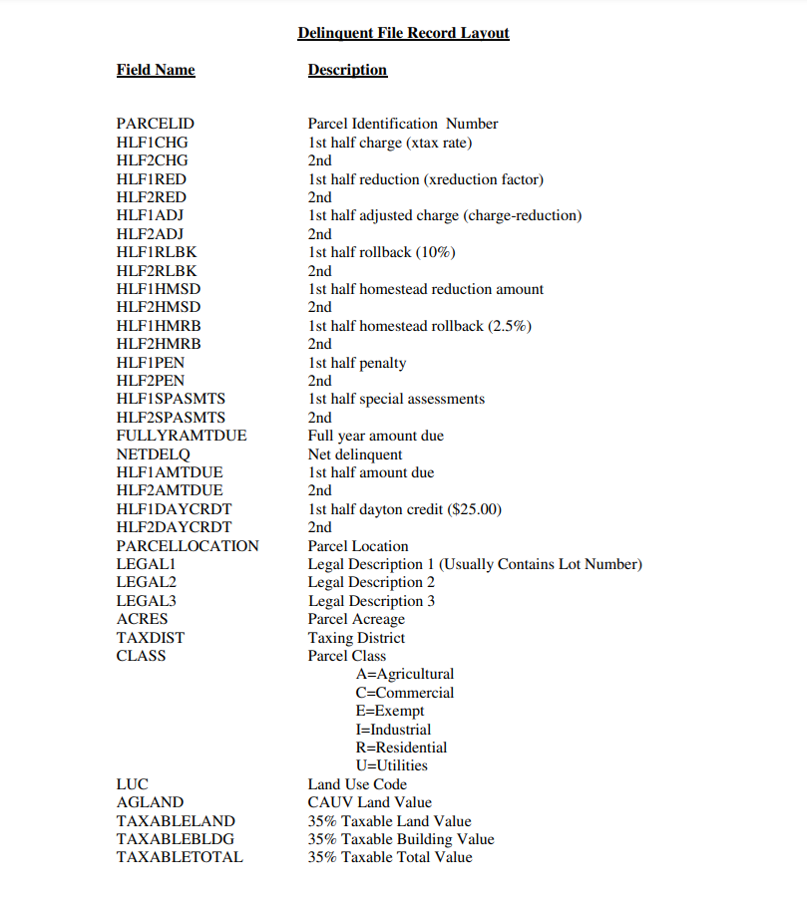
How do I access delinquency data?
This is the first of several pages of the “File Record Layout”. As you will see the in the Delinquent File, there are many rows and columns of data, so you’ll need this information to understand the categories of data provided.

Slide 4
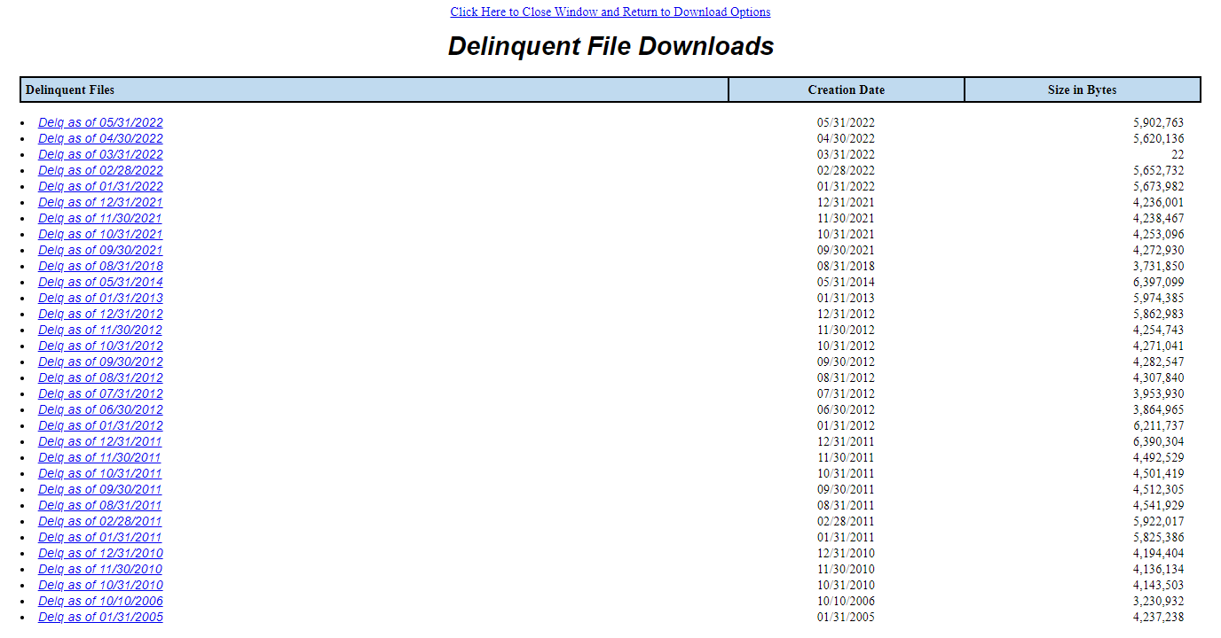
How do I access delinquency data?
When you click on “Delinquent Files”, this is what you will see. The most recent data can be found at the top. If you are interested in comparing current data with past data, you can look at the files below.

Slide 5
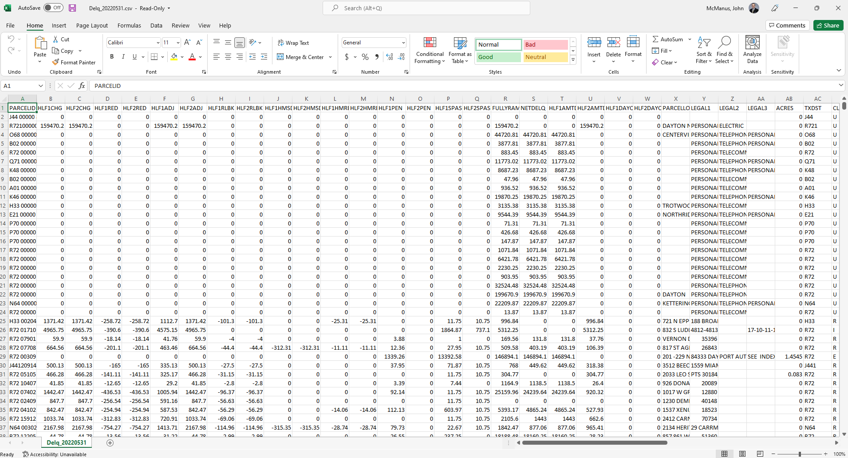
How do I access delinquency data?
When you download a file, it will present itself in Excel format. If you do not have a working knowledge of Microsoft Excel, there are many free online tools to help you learn how to use the program.
As you will see, these spreadsheets are very comprehensive and list *all* parcels that are delinquent. Just because a parcel is on this spreadsheet, it does *not* mean that it is necessarily eligible for foreclosure. Find out why on the next page.

Slide 6
How do I access delinquency data?
While all delinquent parcels are listed on the regular uploads shown earlier, it is important for individuals to thoroughly research a property before assuming that it is eligible for foreclosure. Tax liens, bankruptcies, court cases and delinquent payments plans attached to a property have implications on foreclosure eligibility.
To start a search, click on “Property Search”.

Slide 7
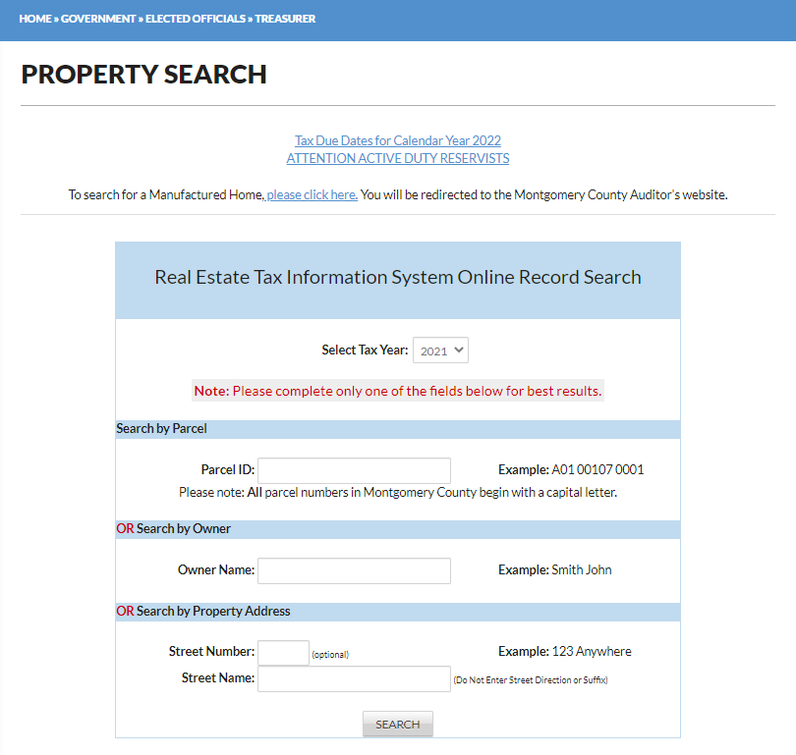
How do I access delinquency data?
Once here, you can pull up properties by either (1) Parcel ID; (2) Owner Name; or (3) Property Address.
As an example, let’s do some research on 4901 Wilmington Pike, an investment property owned by an LLC.
Simply type in “4901” at “Street Number” and “Wilmington” at “Street Name”.

Slide 8
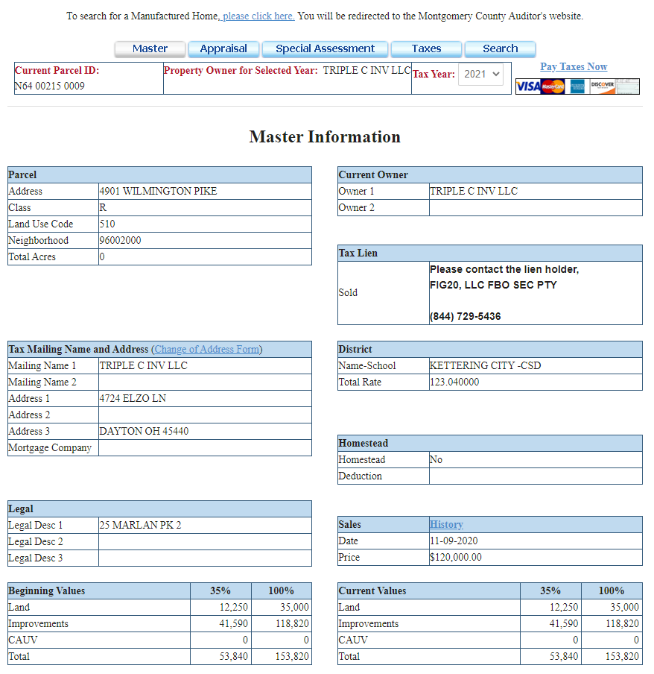
How do I access delinquency data?
Once this property is pulled up, you can see that there was a tax lien sold by the Treasurer’s Office on this property. Tax liens have implications on foreclosure eligibility. That’s why it’s always important to thoroughly research each property before assuming it’s eligible for foreclosure.
To look through a history of the tax payments (or non-payments) on each parcel, click on “Taxes”. If you have trouble understanding how to read the tax page, contact our office and ask for the Delinquency Department.

Slide 9
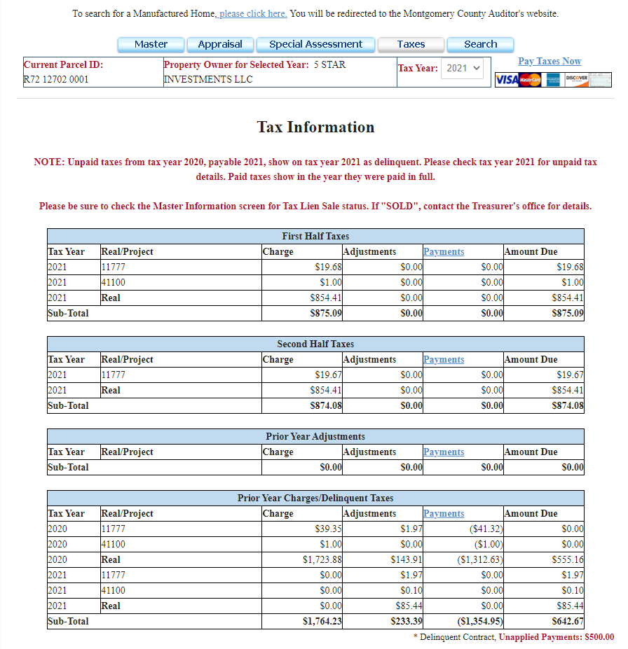
How do I access delinquency data?
Clicking on the “Taxes” tab also has important information that may show factors which would impact foreclosure eligibility on tax delinquent properties.
For instance, 616 Gettysburg Avenue in Dayton is tax delinquent, but its owner has enrolled in a delinquent payment plan. As long as a property owner enrolled in such a plan stays current on payments, it is ineligible for foreclosure. If the plan is voided for lack of payment, its foreclosure eligibility is restored.
You will find the delinquent payment plan indicator here.

Slide 10
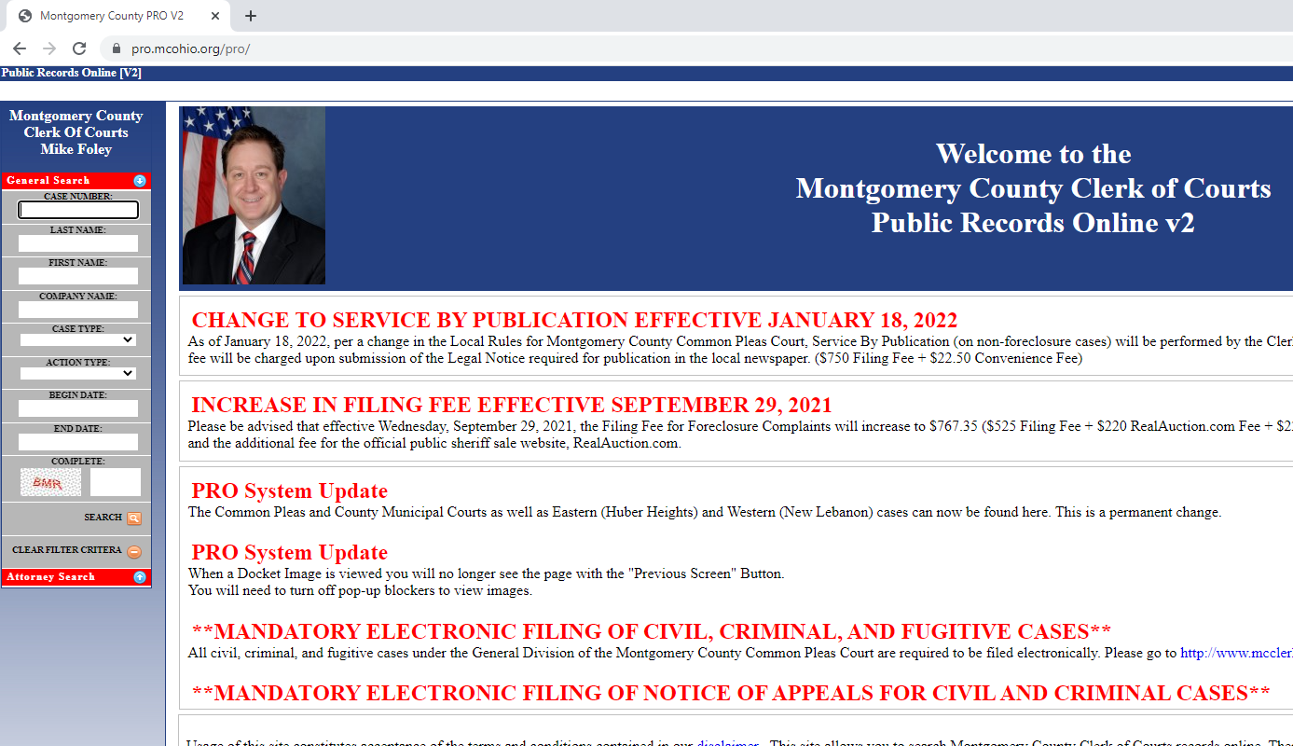
How do I access delinquency data?
In addition to the Treasurer’s website, it is generally advised that interested persons conduct a search on the Clerk of Courts Public Records Online system. The website can be found at: pro.mcohio.org/pro/
Searching the current owner’s name is a good way of determining whether or not there is already an active foreclosure case or other legal issue associated with the property.
If the property is owned by an LLC, type the LLC’s name in the “Company Name” field.

